Slide 1
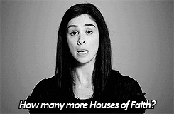
Mass Shootings in America
Teresa Gerhold, Josh Anderson, Nick O’Neill, Merzia Cutlerywala
Notes:
M

Slide 2
Basic Details
Datasets:
Stanford_MSA_Database - contains data about mass shootings in America from 1966 to 2016.
NYTimes API - contains various metadata about every news article from 1966 to 2016 containing the keyword “mass shooting.”
Significant data fields:
City/state, date, fatalities, injured, venue, mental health history, possible motive, type of weapon, number of weapons, shooter name/age/race/gender, fate of the shooter, cause of death, and latitude and longitude of where the shooting occurred.
Average shooter age
Class
Count (Article Count)
Dimensions post cleaning:
Stanford_MSA - 325 observations of 40 variables
Notes:
M + J
Average age - sometimes there would be multiple shooters, this is the average age of all at the incident
Class - An indication of the number of victims and fatalities, as well as the time span and location of the incident and any mention of gang or drug related activity
Count - A count of all the NYTimes articles containing the keyword “mass shooting” within the previous 30 days of the shooting

Slide 3
Data Cleaning
Mutate to aggregate similar factors
Shooter race
Fate of the shooter at the scene
Type of gun
Shooter’s cause of death
Type of place
Targeted victims
Possible motive
Mutate to correct column types
Select to remove description columns - CaseID, Description, Possible Motive Detailed, History of Mental Illness Detailed, Date Detailed, Targeted Victims Detailed, Type of Gun Detailed, Notes, Data Source 1 to 7
Replaced NAs for numeric values with mean
Corrected column types in the NYTimes news dataset
Inner_join Stanford_MSA_Database and NYTimes API
Notes:
M + J
Aggregate variables - some had capitals, some didn’t, and were considered separate variables
Factoring - factors factors, numbers numbers

Slide 4
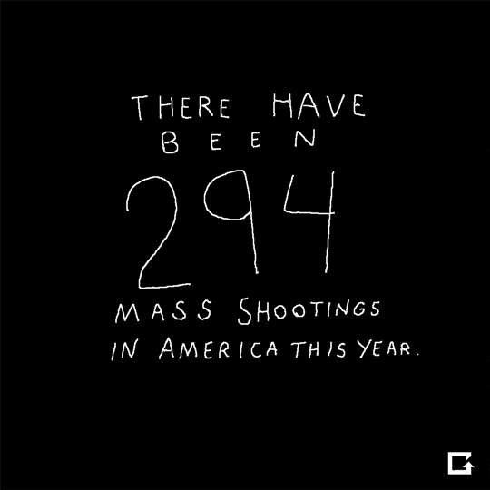
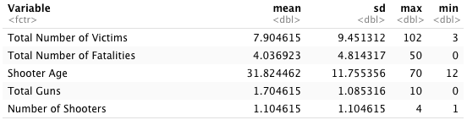
Summary Stats
Notes:
T

Slide 5
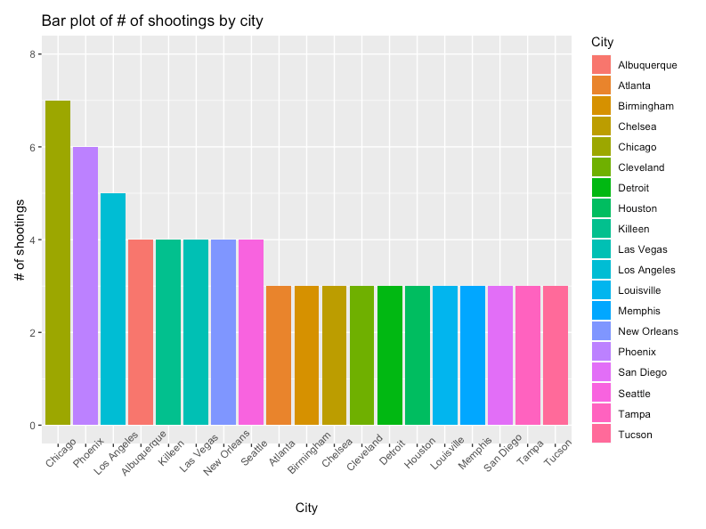
Summary Plots - Histogram based on city
Notes:
N

Slide 6
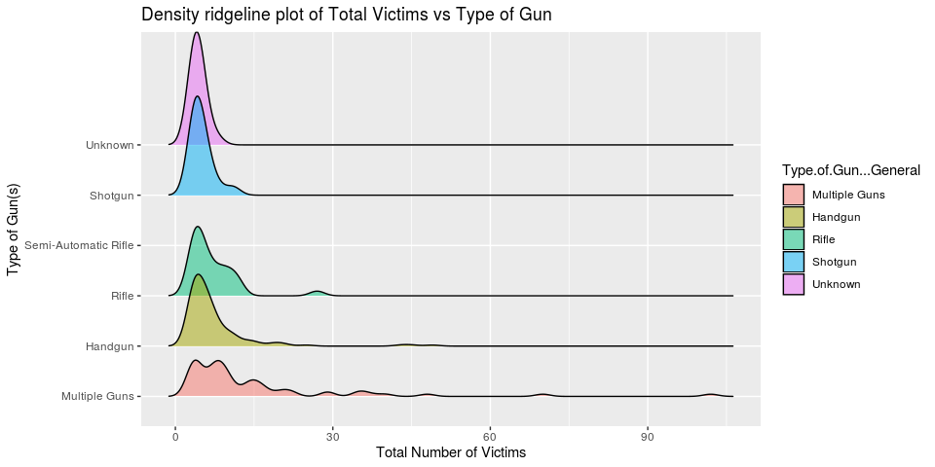
Summary Plots - Victims by Type of Gun
Notes:
N

Slide 7
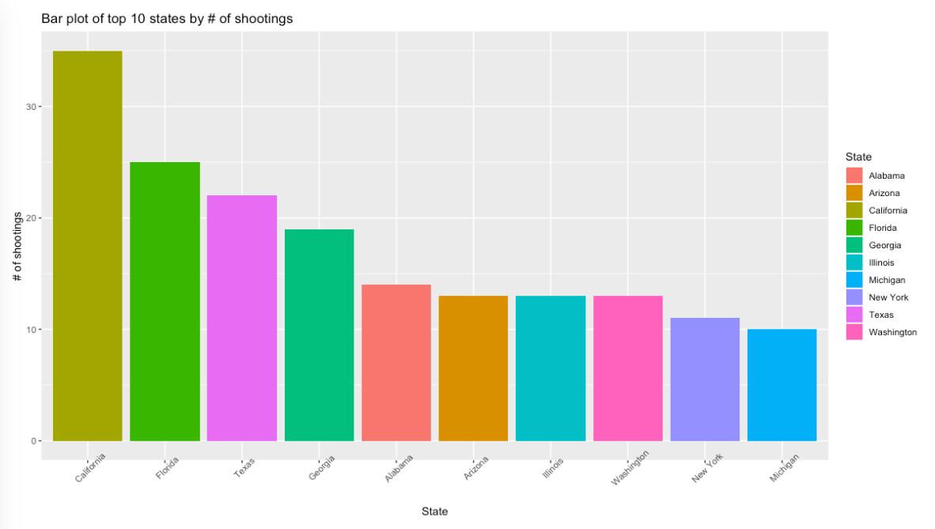
Summary Plots - Bar plot of top 10 states by # of shootings
Notes:
N

Slide 8
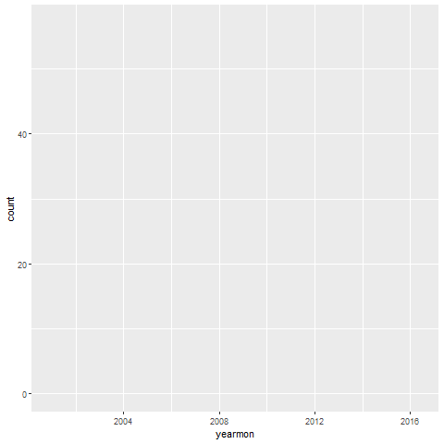
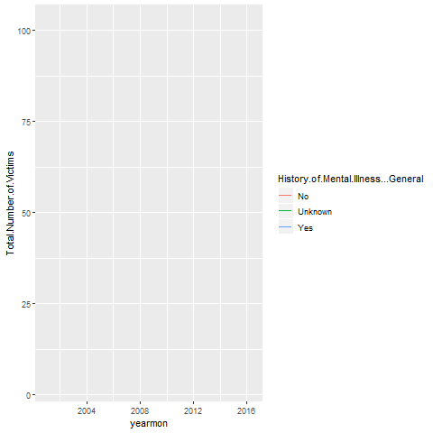
Summary Plots - Line Charts
Notes:
J

Slide 9
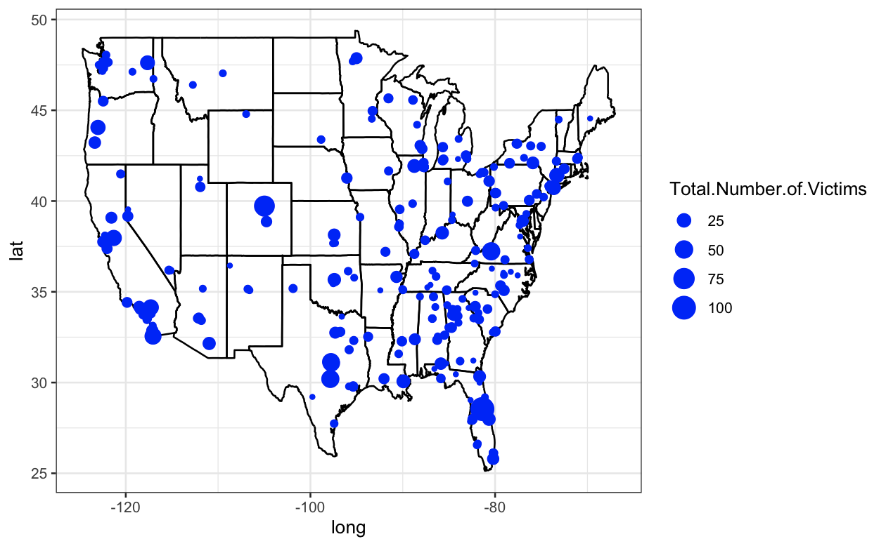
Summary Plots- Location and Number of Victims
Notes:
T

Slide 10

Observations so far …
What parts of America have higher severity shootings
The type of guns impact the number of victims
How many people are at risk in a given mass shooting

Slide 11

Predictive models used
ElasticNet - what predictors cause the severity of a mass shooting
Notes:
T

Slide 12
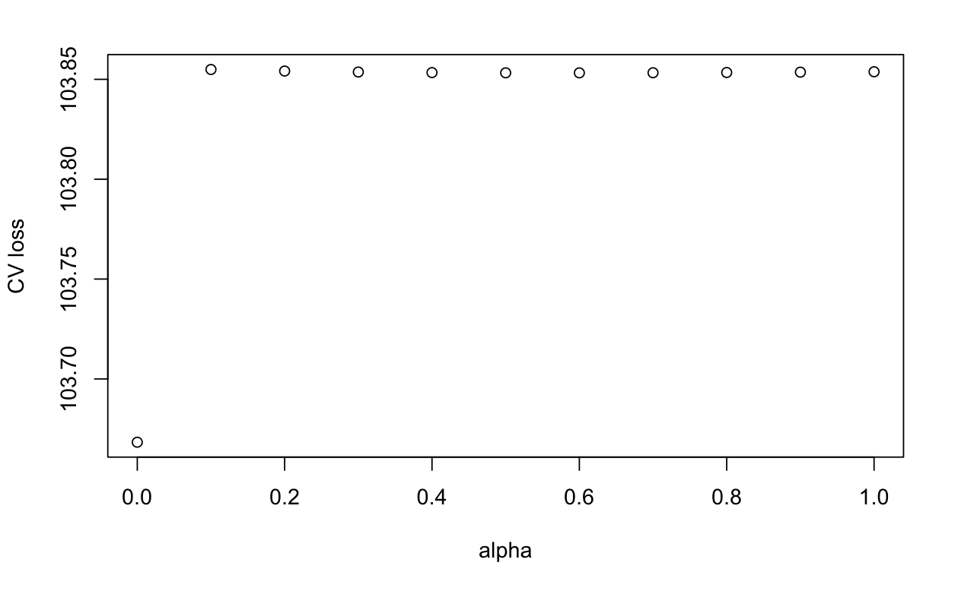
Minloss Plot
Optimal alpha is
alpha = 0 because that’s where cross validated loss is minimized
Should be ridge instead

Slide 13
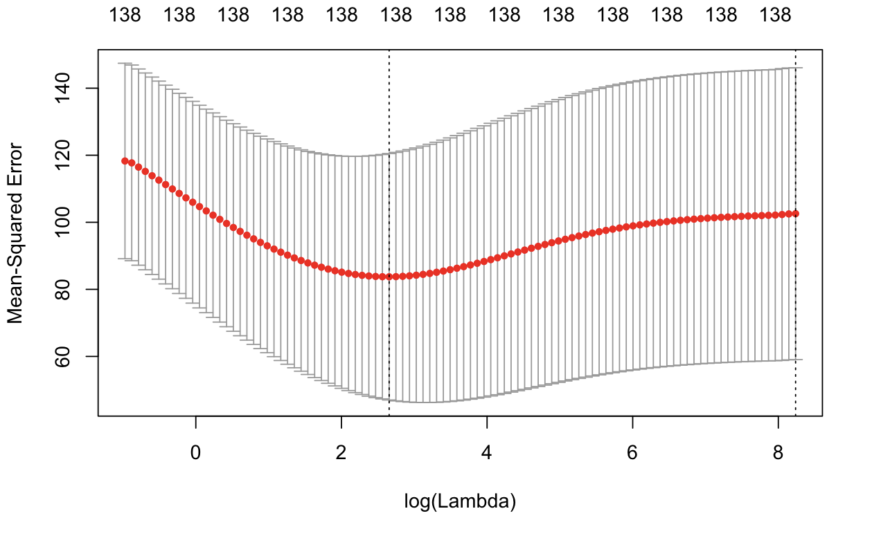
Ridge Diagnostics
Training:
RMSE - 7.158553
MAE - 3.723099
R2 - 0.5912334
Testing:
RMSE - 5.9811
MAE - 4.034448
R2 - 0.178672
Notes:
Doesn’t have good predicting power but significant results

Slide 14
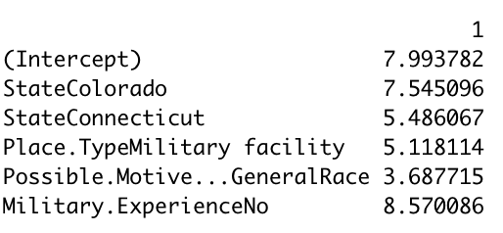
Factors more likely to lead to more victims
Notes:
CA has more but the ones in CO are worse; no military experience is more victims

Slide 15
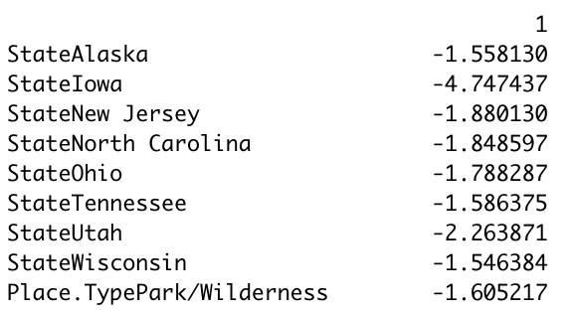
Factors that would likely have fewer total victims

Slide 16

Predictive models used
RandomForest - compare the performance metrics to see which model is better
Notes:
J

Slide 17
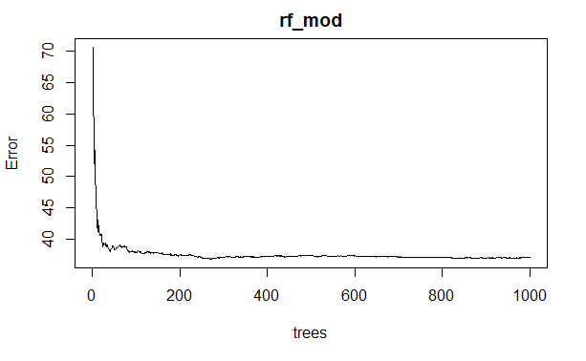
Random Forest Diagnostics
Ntree = 275
Mtry = 6
Type = regression
Training:
RMSE - 2.7437
MAE - 1.451888
R2 - 0.9475252
Testing:
RMSE - 15.21373
MAE - 6.124129
R2 - 0.2661599

Slide 18
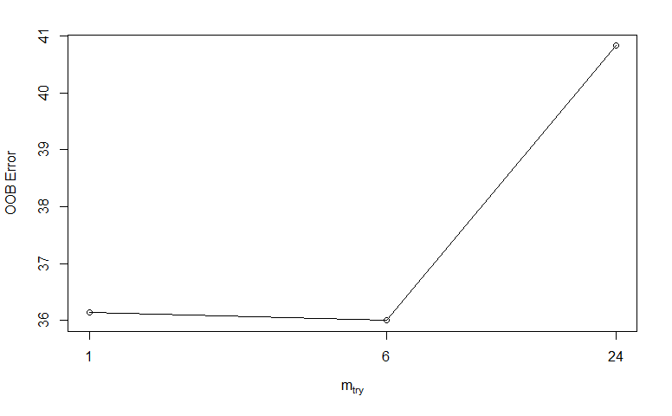
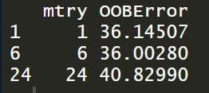
Random Forest Diagnostics - mtry

Slide 19
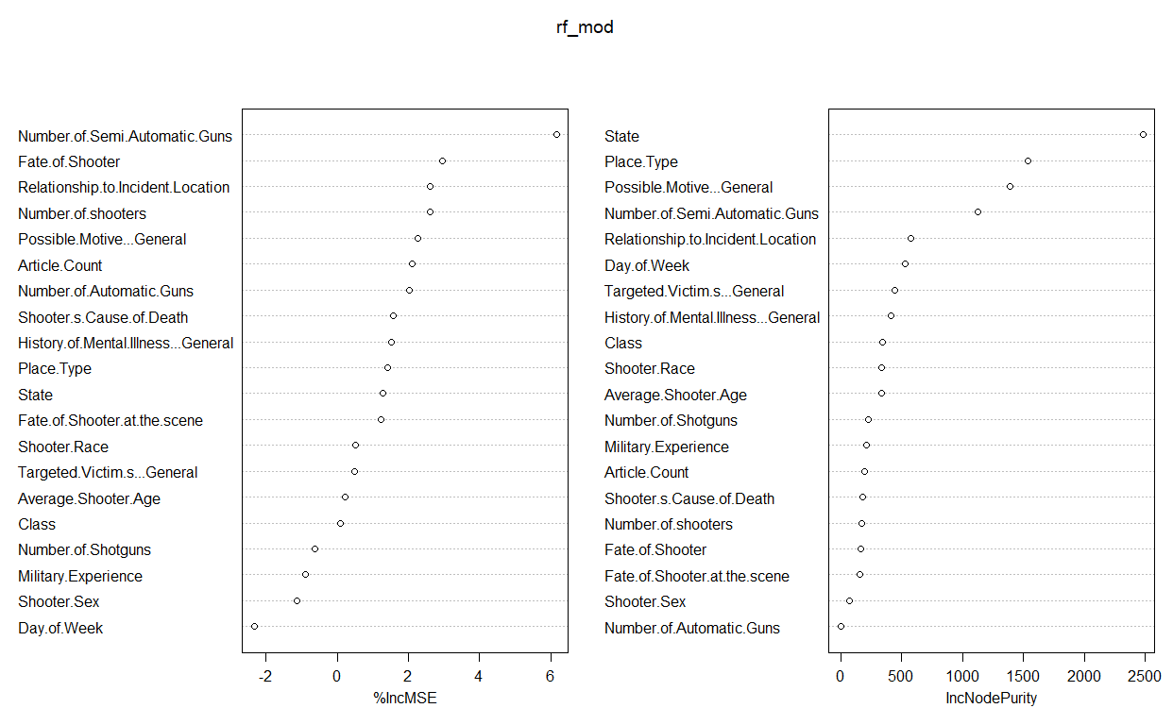

Slide 20
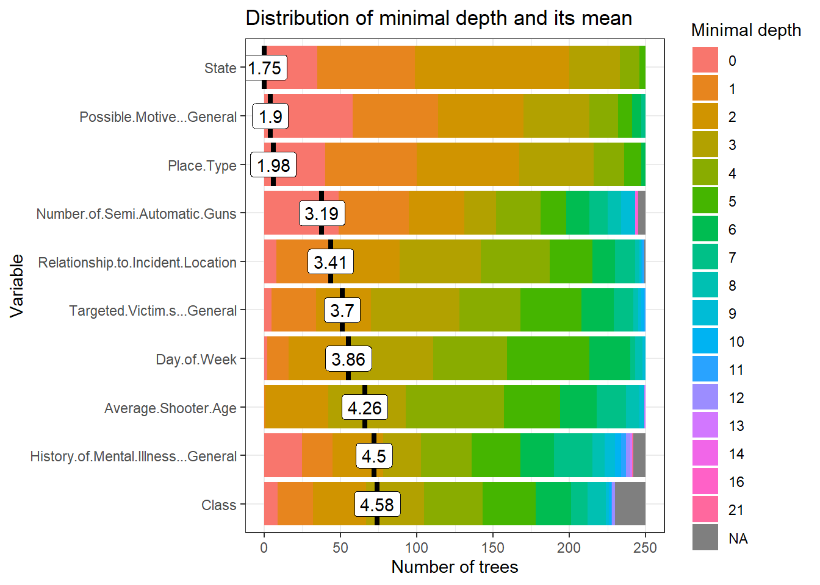

Slide 21
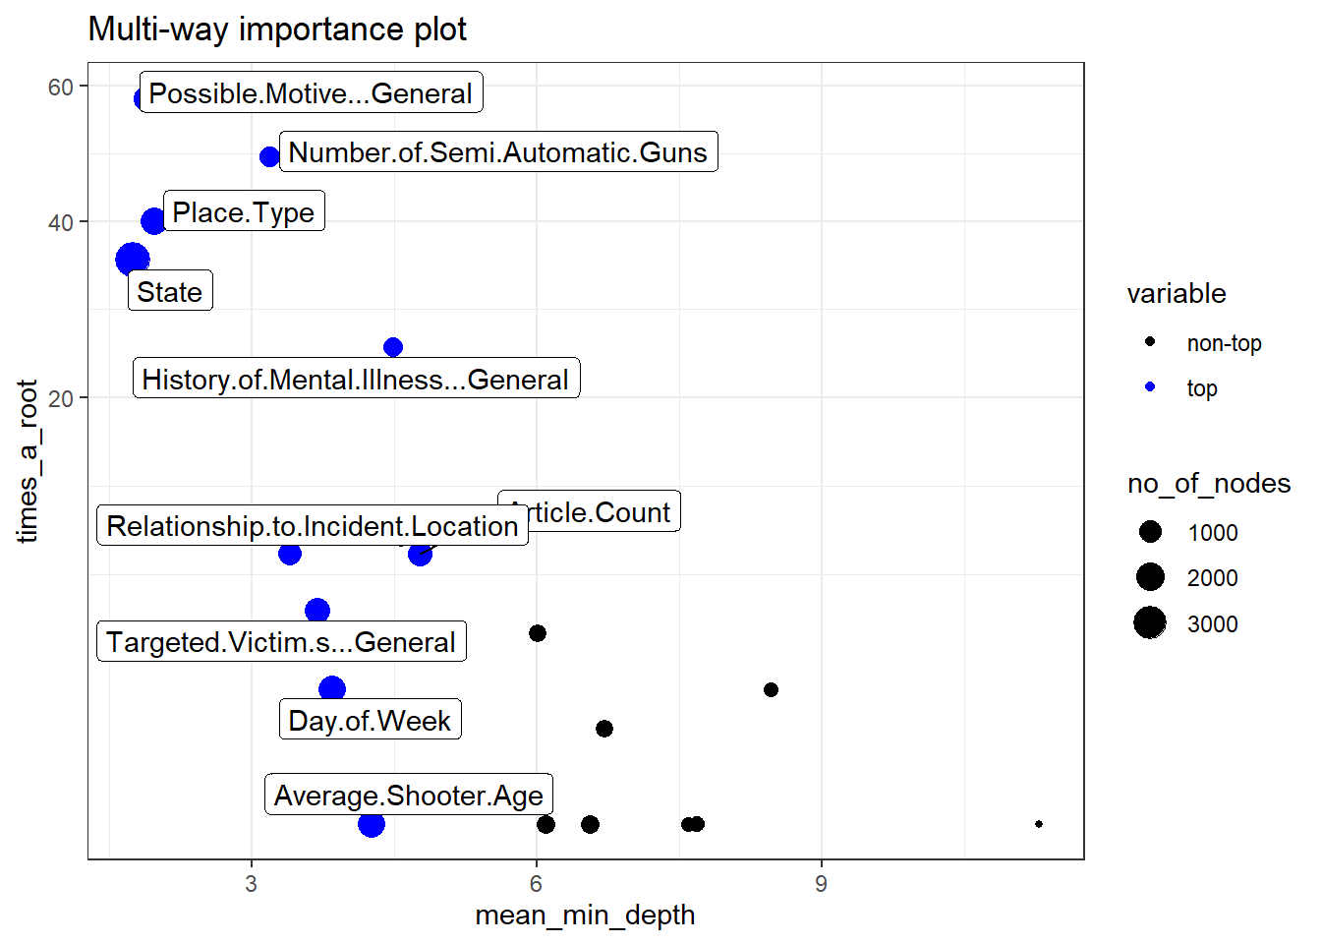
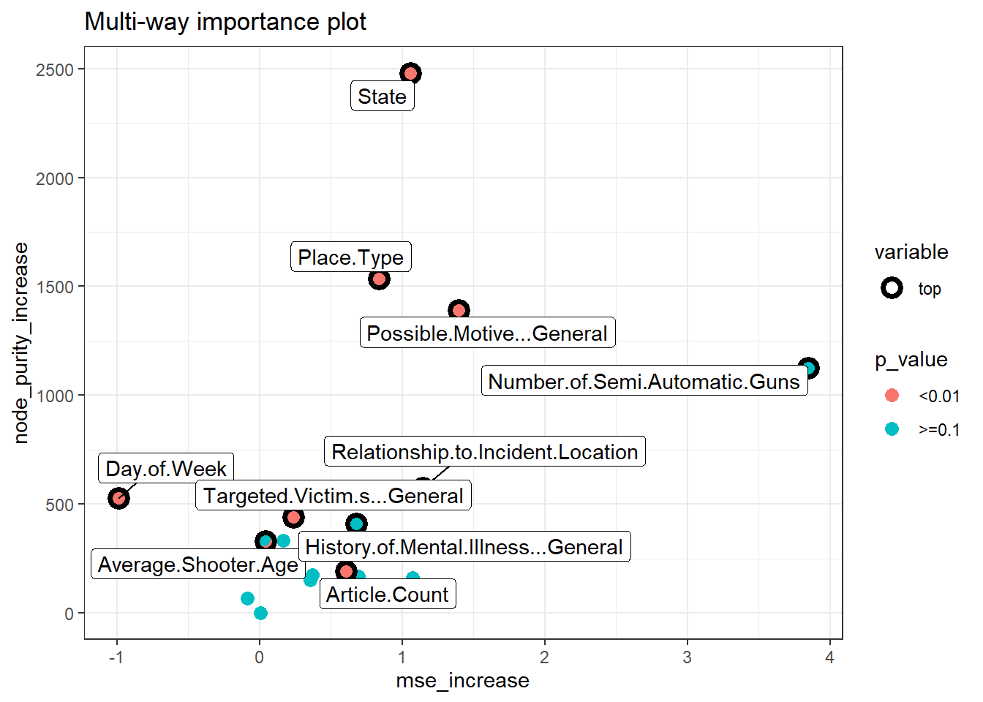
with the additional information on the p-value based on a binomial distribution of the number of nodes split on the variable
(i.e. if a variable is significant it means that the variable is used for splitting more often than would be the case if the selection was random).
mean depth of first split on the variable,
number of trees in which the root is split on the variable,
the total number of nodes in the forest that split on that variable

Slide 22

Predictive models used
K-means - similar characteristics in the different clusters could help us classify the different types of mass shootings that occur
Notes:
N

Slide 23
Selecting Variables
Limited the data to only numeric variables
Noticed that some of variables shown in the random forest were either insignificant or caused a lot of variance
Number of Automatic
Number of Semi Auto
Number of Shotguns
Count
Variables Used
Number of shooters
Total Number of Victims
Average Age

Slide 24
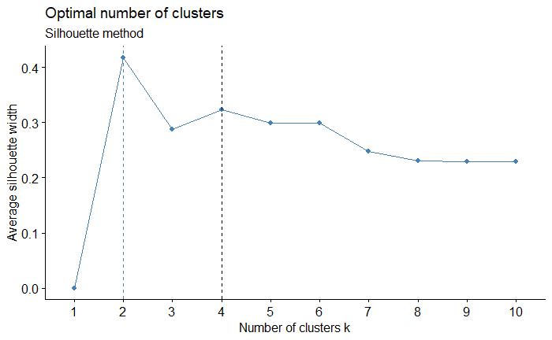
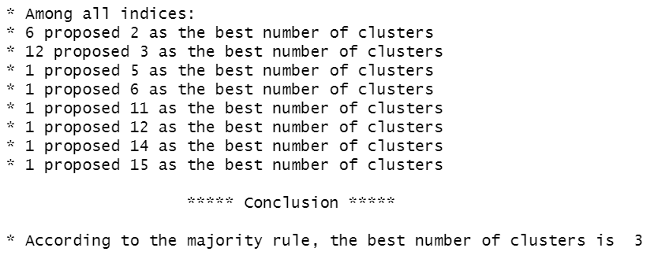
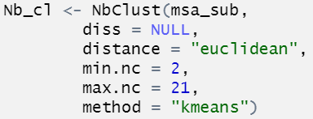
Selecting K
Used NbClust and Silhouette to find number of cluster

Slide 25
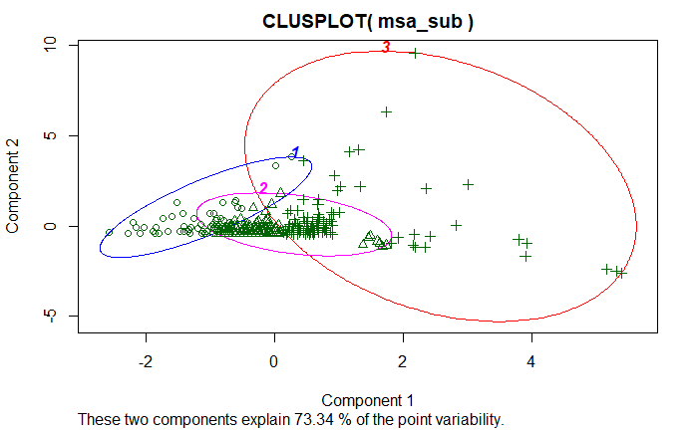

Slide 26
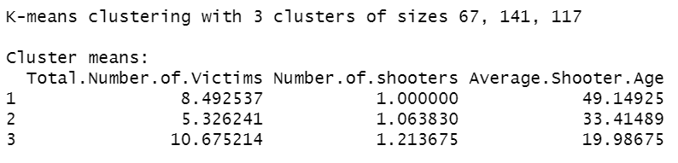
Even though a majority of the shooters are around 30 years of age that demographic seems to have significantly less victims then the other cases.
Cluster 3 has very high variability with having a larger number of the outliers potentially skewing the number to be larger
Despite the potential skew the average seems to generally be larger for cluster 3
Notes:
Age - significant in K-means in terms of the age of people at the location

Slide 27
Business and practical management
Mass shootings have become a major problem in the United States
Useful for organizations to track information on students, employees, etc. to be aware of how many people are at risk in a given situation and what factors they could change to reduce that number
While not being able to predict whether a shooting will happen or the severity accurately, we have found variables that clearly have a significant impact if a shooting were to occur.
Addressing these factors can limit the people at risk in a mass shooting:
State
Place Type
Possible Motive
Relationship to Incident Location
Notes:
M
We care less about how much we can predict, but ideally this predicted significant factors
Shooters relationship to the location of the shooting

Slide 28
Thank you!

